Slide 1

Introduction to Business Rules
DYNAMICS 365

Slide 2

Mitch Milam
Dynamics CRM Architect
mitch@xrmcoaches.com
@mitchmilam
http://tinyurl.com/MitchMilamLinkedIn

Slide 3
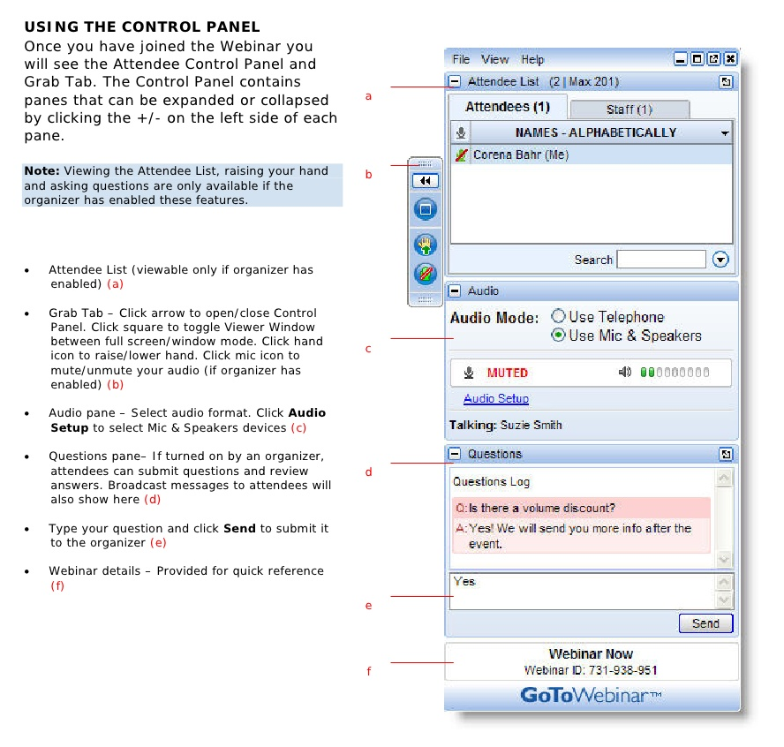
Webinar Housekeeping

Slide 4



2017 Training Roadmap
Webinars
http://www.xrmcoaches.com/webinars
KnowledgeBits
http://www.xrmcoaches.com/knowledgebits
Learning Plans
http://www.xrmcoaches.com/freestuff
More Goodies
Practice tests
On–Demand video training
Instructor–led training
Books

Slide 5
Agenda
Business Rule basics
Configuration
Usage

Slide 6
Who is this For?
Non–developers
Administrators
Even developers

Slide 7
Limitations
Only run when the form loads and when field values change. They do not run when a record is saved, unless the scope for the rule is set at an entity level.
Business rules work only with fields.
When you set a field value by using a business rule, any OnChange event handlers for that field will not run.
If a business rule references a field that is not present on a form, the rule will simply not run.

Slide 8
Limitations cont.
Whole Number fields that use the formats for TimeZone, Duration, or Language will not appear in the rule editor for the conditions or actions, so they cannot be used with business rules.
For Microsoft Dynamics CRM for tablets, the definition of the business rules are downloaded and cached when CRM for tablets opens. Changes made to business rules are not applied until CRM for tablets is closed and re-opened.
When you set the value of a lookup field, the text of the primary field value that is set in the form will always match the text that is visible in the rule definition

Slide 9
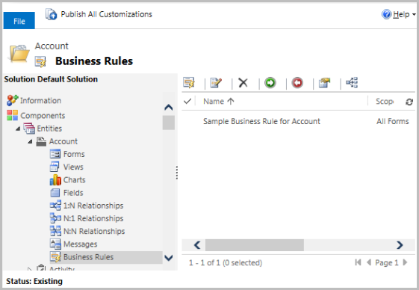
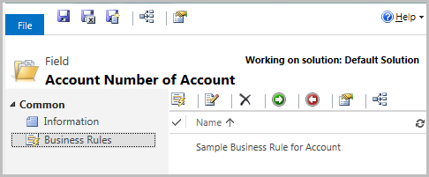
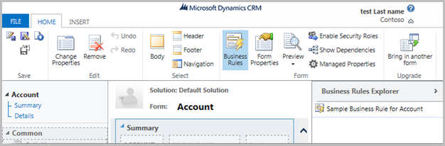
Where do you find Business Rules?

Slide 10

Scope
Where should this rule run?

Slide 11
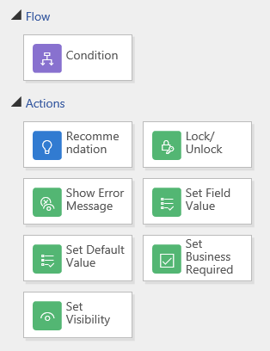
What do Business Rules Do?

Slide 12
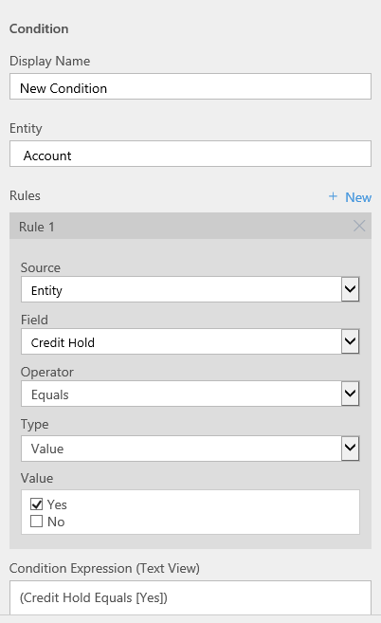
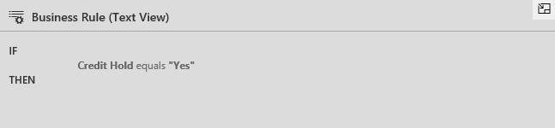
Conditions
If/then/else
Works on the Entity or a business process

Slide 13
Actions
What task can we perform?

Slide 14
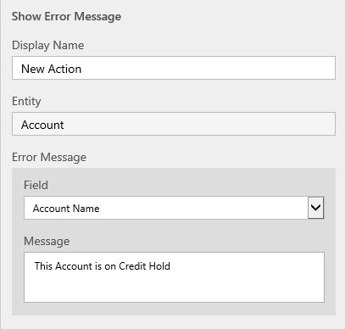
Show Error Message
Display at the field level

Slide 15
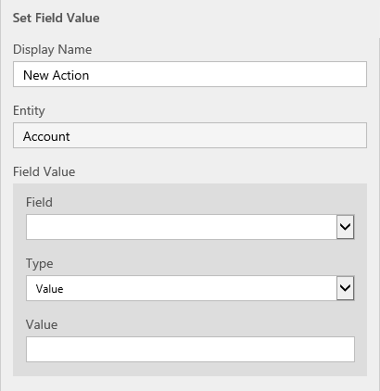
Set Field Value
Can be set to a value, formula, field or cleared

Slide 16
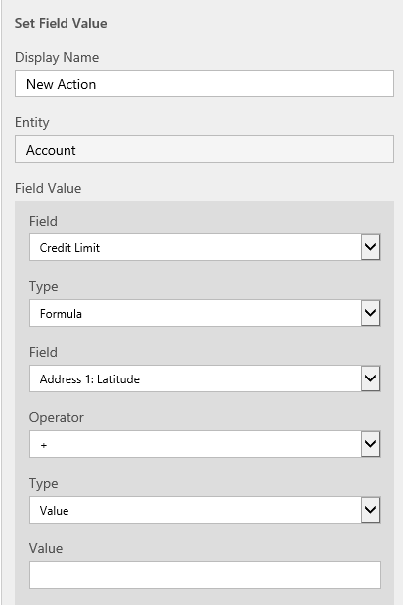
Set Field Value (formula)
Use simple operators (+,–,/,*)
Can use a field value or a static value

Slide 17
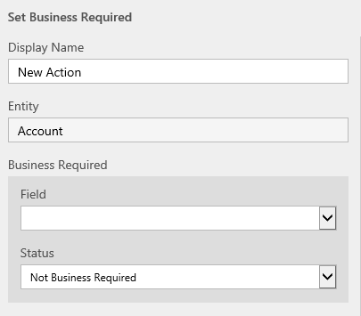
Set Business Required
Can set to either required or not

Slide 18
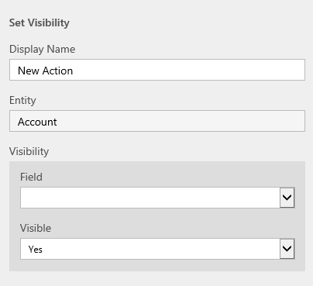
Set Visibility
Only works on fields – not on Tabs or Sections

Slide 19
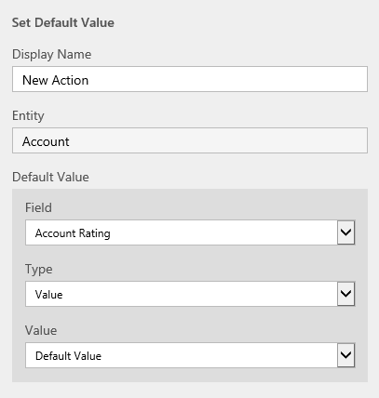
Set Default Value
Can be set to a field value or a static value

Slide 20
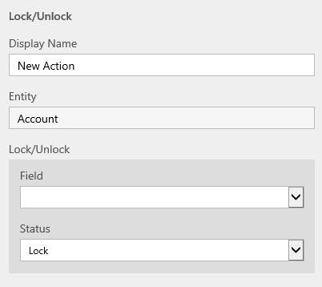
Lock or Unlock Field
Sets a field to read–only or editable

Slide 21
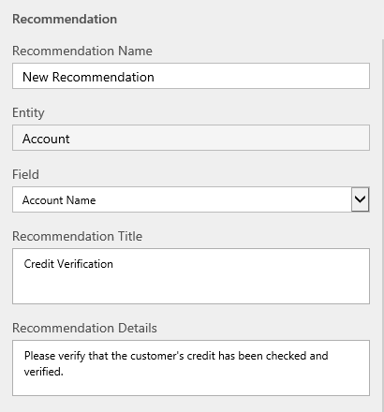
Recommendation
Displays a recommendation on a field

Slide 22
Advantages
Easy to create
No JavaScript knowledge required
Can run at the server level
Can run on multiple devices/platforms

Slide 23
Disadvantages
It is sometimes hard to understand where the logic lies
JavaScript
Business Rules
Plugins
Synchronous workflows
Asynchronous workflows

Slide 24
Additional Reading
Create and edit business rules (Help and Training)
https://www.microsoft.com/en-us/Dynamics/crm-customer-center/create-business-rules-and-recommendations-to-apply-logic-in-a-form.aspx

Slide 25
Questions?

Slide 26
Thank You

